Slide 1



Chapter 2
Information Systems in
Organizations
Information Systems, Tenth Edition & Some other resources

Slide 2
Principles and Learning Objectives
The use of information systems to add value to the organization is strongly influenced by organizational structure, culture, and change
  Identify the value-added processes in the supply chain and describe the role of information systems within them
  Provide a clear definition of the terms “organizational structure,” “culture,” and “change” and discuss how they affect the type of information systems that the organization implements

Slide 3
Principles and Learning Objectives (continued)
Because information systems are so important, businesses need to be sure that improvements or completely new systems help lower costs, increase profits, improve service, or achieve a competitive advantage
  Define the term “competitive advantage” and identify the factors that lead firms to seek competitive advantage
  Discuss strategic planning for competitive advantage
  Describe how the performance of an information system can be measured

Slide 4
Principles and Learning Objectives (continued)
IS personnel is a key to unlocking the potential of any new or modified system
  Define the types of roles, functions, and careers available in the field of information systems

Slide 5
Organizations and Information Systems
Organization:
  Definition :Formal collection of people and other resources established to accomplish a set of goals
  A system : Why
    has inputs, processing mechanisms, outputs and feedbacks
  Constantly uses money, people, materials, machines and other equipment, data, information, and decisions

Slide 6
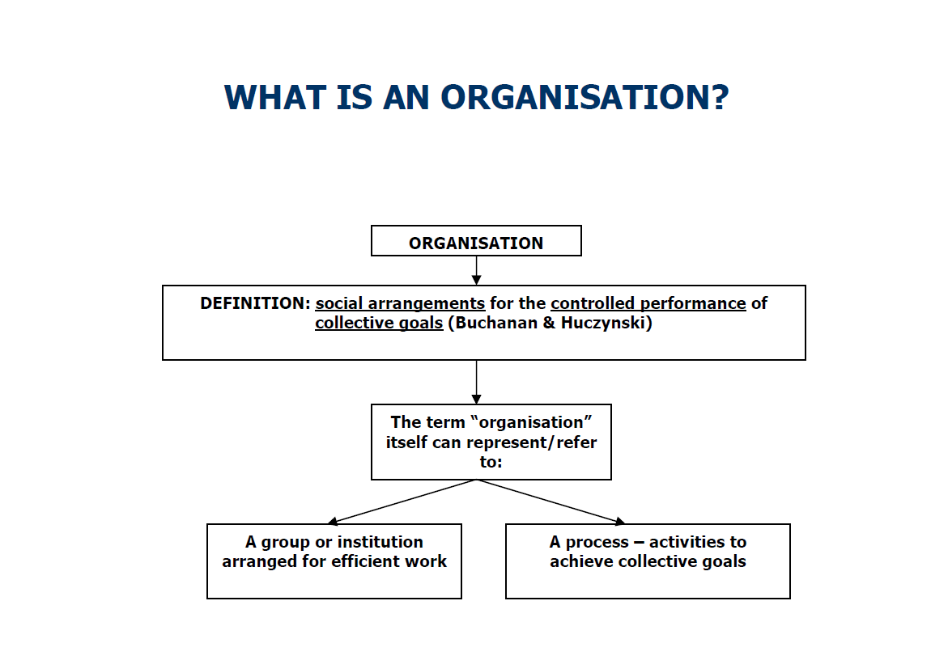
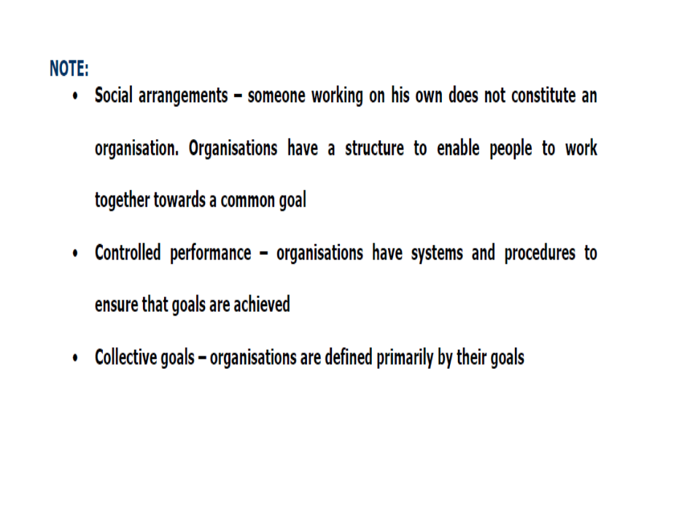
Others Definitions: Organisation
A social unit of people that is structured and managed to meet a need or to pursue collective goals. All organizations have a management structure that determines relationships between the different activities and the members, and subdivides and assigns roles, responsibilities, and authority to carry out different tasks. Organizations are open systems--they affect and are affected by their environment.

Slide 7
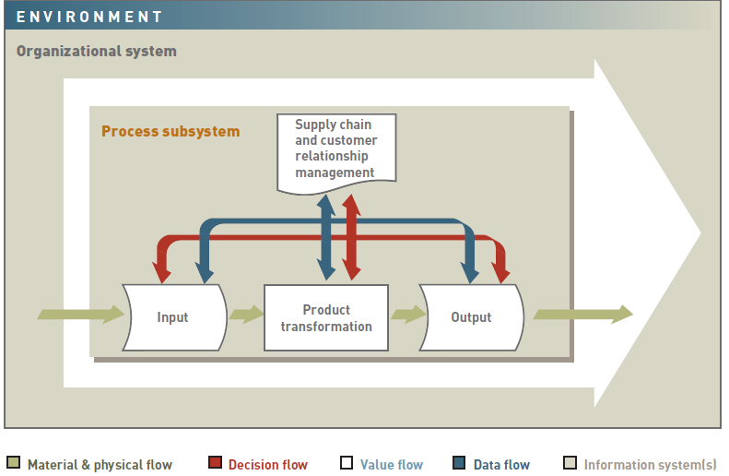
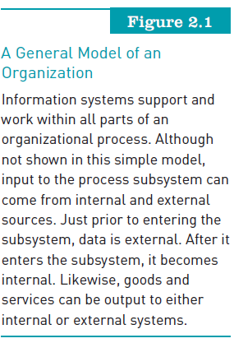
Organizations and Information Systems (continued)
Information Systems, Tenth Edition

Slide 8
Organizations and Information Systems (continued)
IS provides values for stakeholders. Who??
Value chain:
  Series (chain) of activities that includes inbound logistics and warehouse and storage
Supply chain management (SCM)
  Determines:
    What supplies are required for value chain
    What quantities are needed to meet customer demand
    How supplies should be processed into finished goods and services
    How shipment of supplies and products to customers should be scheduled, monitored, and controlled

Slide 9
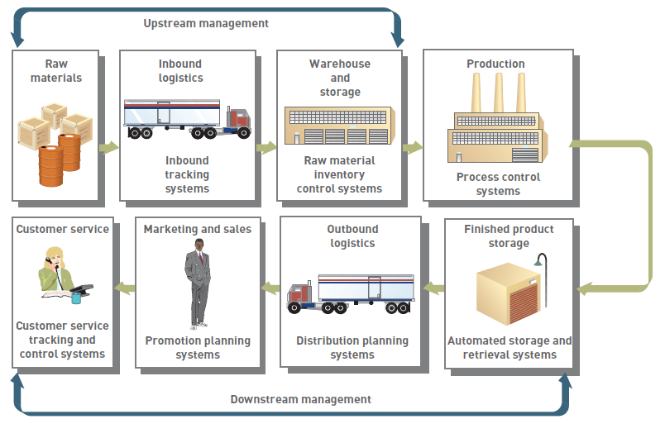
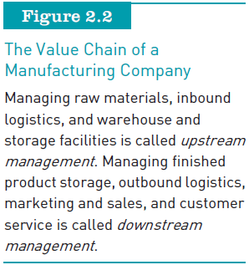
Organizations and Information Systems (continued)
Information Systems, Tenth Edition

Slide 10
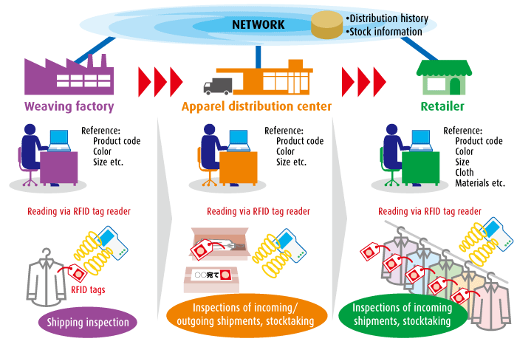

Example of supply-chain management for apparel company (management of orders, stock and distribution)
http://www.soumu.go.jp/menu_seisaku/ict/u-japan_en/new_r_i01m.html

Slide 11
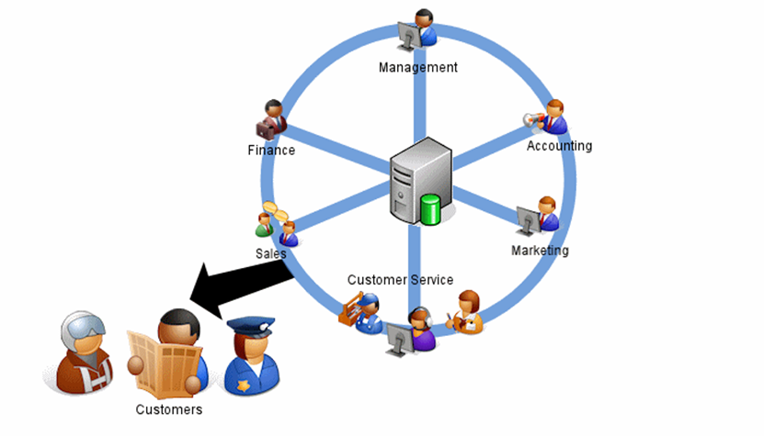
Organizations and Information Systems (continued)
Customer relationship management (CRM) programs:
  Help companies manage all aspects of customer encounters
  Can get customer feedback to help design new products and services
  Example/Activity : “Try SugarCRM”
  http://www.sugarcrm.com/try-sugar

Slide 12
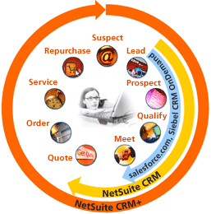
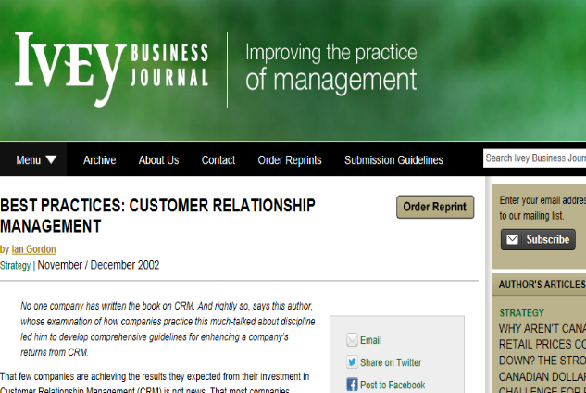
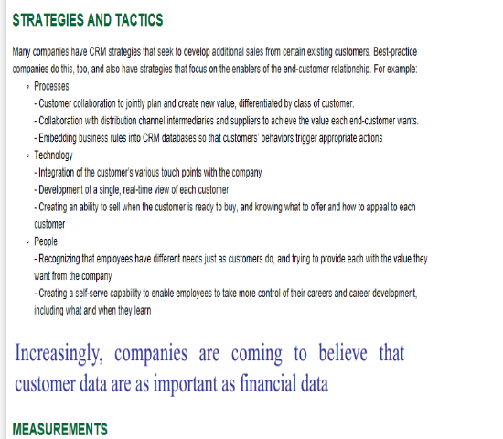
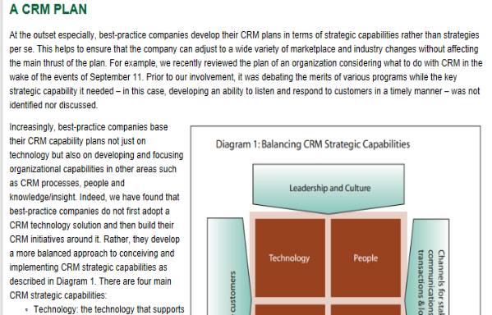
Example1: JD Edwards World and Siebel CRM On Demand
http://it.toolbox.com/blogs/integrate-my-jde/jd-edwards-world-and-siebel-crm-on-demand-17617
http://www.youtube.com/watch?v=bCxJ1UzhRd8
Example 2: BEST PRACTICES:
CUSTOMER RELATIONSHIP MANAGEMENT
http://iveybusinessjournal.com/topics/strategy/best-practices-customer-relationship-management#.UkEQd2ywrcs

Slide 13
Organizational Structures
Organizational structure:
  Organizational subunits and the way they relate to the overall organization
Types of organizational structures:
  Traditional
  Project
  Team : Teams in Malaysia Manufacturing SMEs - eg: UM Research - Malaysia http://eprints.rclis.org/19408/
  Virtual http://eprints.um.edu.my/2574/1/AMR.433-440.1653.pdf
Information Systems, Tenth Edition

Slide 14
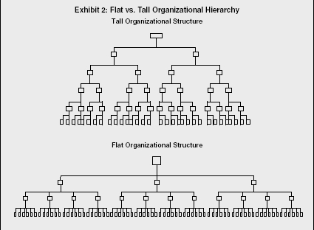
Organizational Structures (continued)
Traditional organizational structure:
  Hierarchy of decision making and authority flows:
    From the strategic management at the top down to operational management and nonmanagement employees
  Flat organizational structure:
    Empowers employees at lower levels
  Empowerment:
    Gives employees and their managers more responsibility and authority to make decisions
Information Systems, Tenth Edition

Slide 15
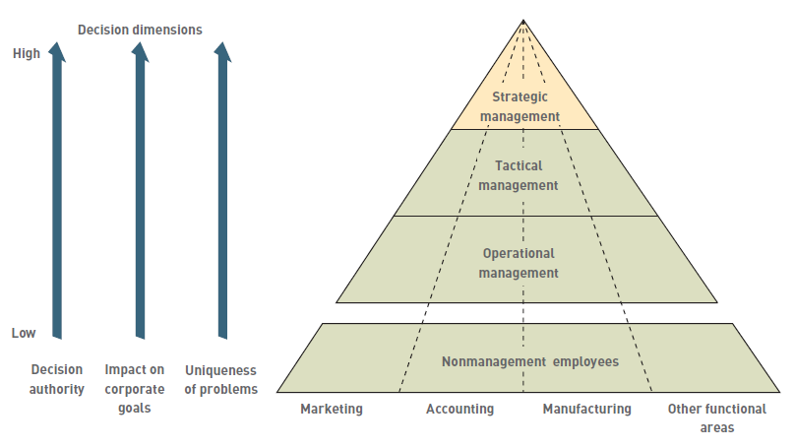
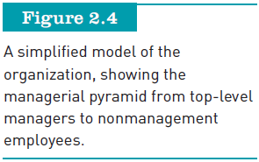
Organizational Structures (continued)
Information Systems, Tenth Edition

Slide 16
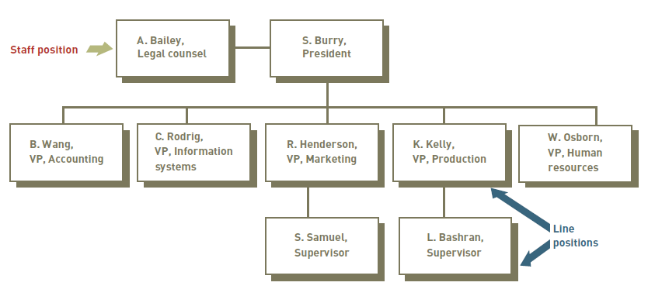
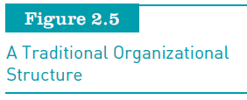
Organizational Structures (continued)
Information Systems, Tenth Edition

Slide 17
Organizational Structures (continued)
Project and team organizational structures:
  Project organizational structure:
    Centered on major products or services
    Many project teams are temporary
  Team organizational structure:
    Centered on work teams or groups
    Team can be temporary or permanent, depending on tasks
Information Systems, Tenth Edition

Slide 18
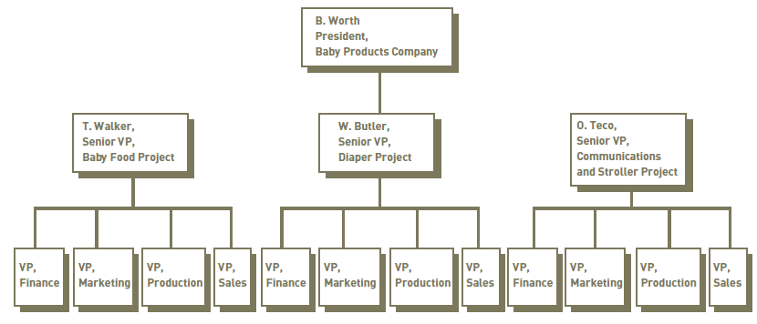

Organizational Structures (continued)
Information Systems, Tenth Edition

Slide 19
Organizational Structures (continued)
Virtual organizational structure and collaborative work: ( Teleworking)
  Virtual organizational structure:
  http://www.organizationstructure.org/virtual.html
  http://eprints.usm.my/2728/1/Telework_Implementation_Toward_Virtual_Organization_In_Malaysia.pdf
    Uses individuals, groups, or complete business units in geographically dispersed areas
    Can reduce costs for an organization
  Allows collaborative work:
    Managers and employees can effectively work in groups, even those composed of members from around the world

Slide 20
Organizational Culture and Change
Culture:
  Set of major understandings and assumptions shared by a group
Organizational culture:
  Major understandings and assumptions
  Influences information systems
Organizational change:
  How organizations plan for, implement, and handle change
Information Systems, Tenth Edition

Slide 21
Organizational Culture and Change (continued)
Change model:
  Represents change theories by identifying phases of change and the best way to implement them
Unfreezing:
  Ceasing old habits and creating a climate that is receptive to change
Moving:
  Learning new work methods, behaviors, and systems
Information Systems, Tenth Edition

Slide 22
Organizational Culture and Change (continued)
Refreezing:
  Involves reinforcing changes to make the new process second nature, accepted, and part of the job
Organizational learning:
  The adaptations to new conditions or adjustments based on experience and ideas over time
Information Systems, Tenth Edition

Slide 23
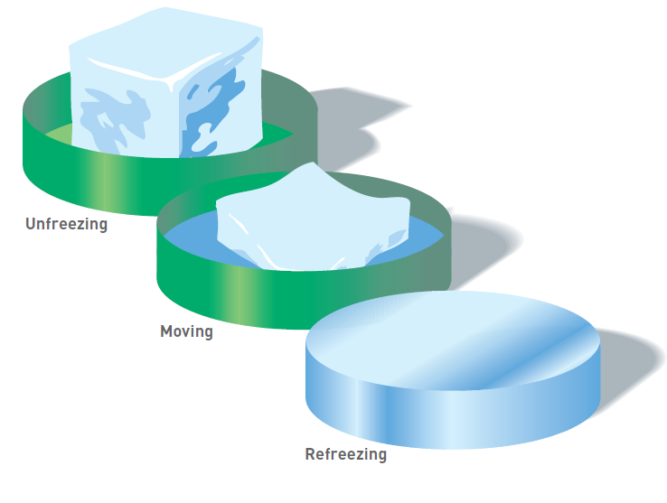

Organizational Culture and Change (continued)
Information Systems, Tenth Edition

Slide 24
Reengineering and Continuous Improvement
Reengineering:
  Process redesign
  Radical redesign of business processes, organizational structures, information systems, and values of the organization to achieve a breakthrough in business results
Continuous improvement:
  Constantly seeking ways to improve business processes and add value to products and services
Information Systems, Tenth Edition

Slide 25
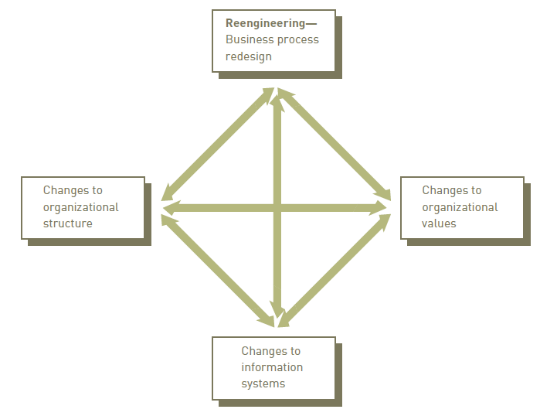
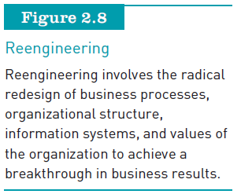
Reengineering and Continuous Improvement (continued)
Information Systems, Tenth Edition

Slide 26
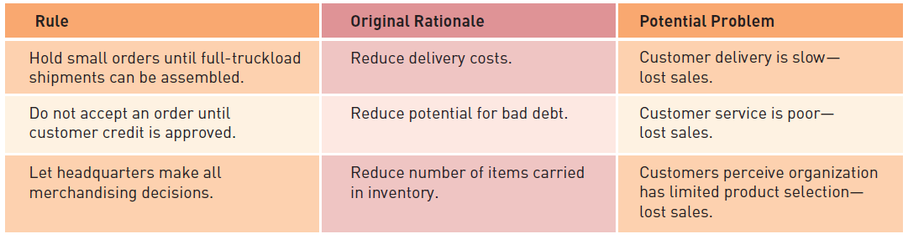
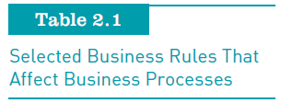
Reengineering and Continuous Improvement (continued)
Information Systems, Tenth Edition

Slide 27
User Satisfaction and Technology Acceptance
Reengineering and continuous improvement must give good result:
  user satisfied,
  technology is used in the organization
User satisfaction: depend on the quality of the system and the value of the information
Technology acceptance within the organizations
Information Systems, Tenth Edition

Slide 28
User Satisfaction and Technology Acceptance
Technology acceptance model (TAM):
  Specifies the factors that can lead to better attitudes about the information system
Technology diffusion:
  Measure of how widely technology is spread throughout an organization
Technology infusion:
  Extent to which technology permeates a department
Information Systems, Tenth Edition

Slide 29
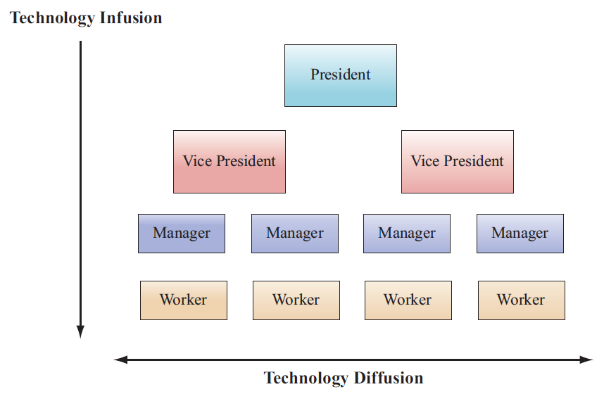
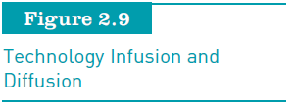
User Satisfaction and Technology Acceptance (continued)
Information Systems, Tenth Edition

Slide 30
Outsourcing, On-Demand Computing, and Downsizing
Outsourcing:
  Contracting with outside professional services
On-demand computing:
  Also called on-demand business or utility computing
  Rapidly responding to the organization’s flow of work as the need for computer resources varies
Downsizing:
  Reducing number of employees to cut costs
Information Systems, Tenth Edition

Slide 31
Competitive Advantage
Significant and (ideally) long-term benefit to a company over its competition
Can result in higher-quality products, better customer service, and lower costs
Information Systems, Tenth Edition

Slide 32
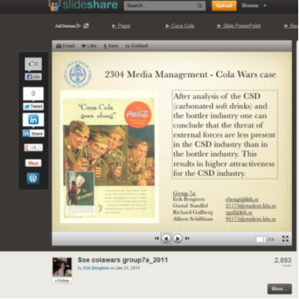
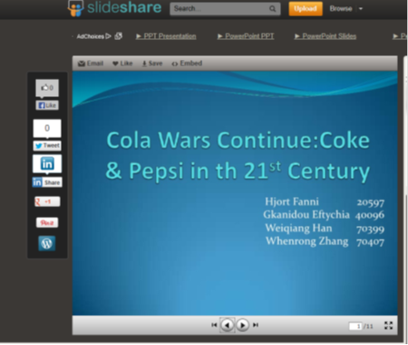
Factors That Lead Firms to Seek Competitive Advantage
The five forces model:
  Rivalry among existing competitors
  Threat of new entrants
  Threat of substitute products and services
  The bargaining power of buyers
  The bargaining power of suppliers
Additional Reading & Example
http://www.slideshare.net/amitanshu/porters-5-force-model

Slide 33
Factors That Lead Firms to Seek Competitive Advantage (continued)
Rivalry among existing competitors:
  Industries with stronger rivalries tend to have more firms seeking competitive advantage
Threat of new entrants:
  Threat appears when:
    Entry and exit costs to an industry are low
    Technology needed to start and maintain a business is commonly available
Information Systems, Tenth Edition

Slide 34
Factors That Lead Firms to Seek Competitive Advantage (continued)
Threat of substitute products and services:
  The more consumers can obtain similar products and services that satisfy their needs, the more likely firms are to try to establish competitive advantage
Bargaining power of customers and suppliers:
  When customers have a lot of bargaining power, companies increase their competitive advantage to retain their customers
Information Systems, Tenth Edition

Slide 35
Chapter’s Activity
Search the following type of organisation in Malaysia Company/Industry
Types of organizational structures:
  Traditional
  Project
  Team : Research paper - Teams in Malaysia Manufacturing SMEs - eg: UM Research - Malaysia http://eprints.rclis.org/19408/
  Virtual
Information Systems, Tenth Edition

Slide 36
Strategic Planning for Competitive Advantage
Strategies:
  Cost leadership
  Differentiation
  Niche strategy
  Altering the industry structure
  Creating new products and services
  Improving existing product lines and service
Information Systems, Tenth Edition

Slide 37
Strategic Planning for Competitive Advantage (continued)
Other strategies:
  Growth in sales
  First to market
  Customizing products and services
  Hiring the best people
  Innovation
Information Systems, Tenth Edition

Slide 38
Performance-Based Information Systems
Major stages in the use of information systems:
  Cost reduction and productivity
  Competitive advantage
  Performance-based management
Information Systems, Tenth Edition

Slide 39
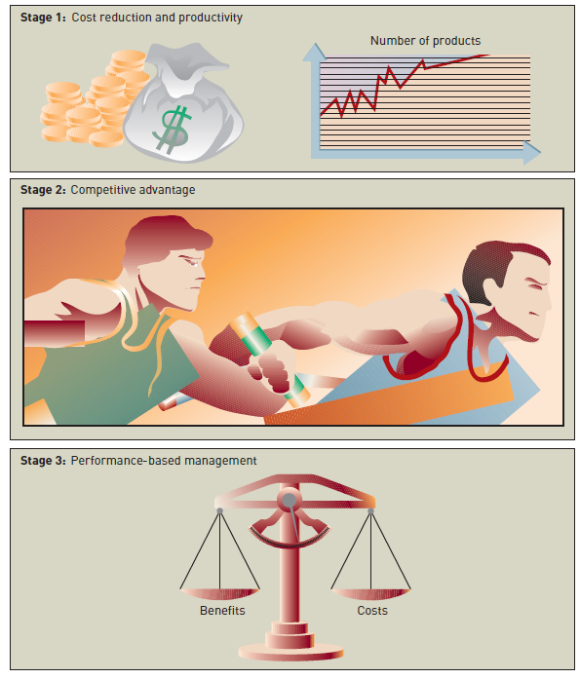
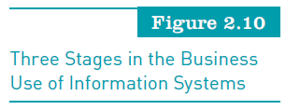
Information Systems, Tenth Edition

Slide 40
Productivity
A measure of output achieved divided by input required
Higher level of output for a given level of input means greater productivity
Lower level of output for a given level of input means lower productivity
Productivity = (Output / Input) × 100%
Information Systems, Tenth Edition

Slide 41
Return on Investment and the Value of Information Systems
Return on investment (ROI):
  One measure of IS value
  Investigates the additional profits or benefits that are generated as a percentage of the investment in IS technology
Earnings growth
  The increase in profit that the system brings
Information Systems, Tenth Edition

Slide 42
Return on Investment and the Value of Information Systems (continued)
Market share and speed to market:
  The percentage of sales that a product or service has in relation to the total market
Customer awareness and satisfaction:
  Performance measurement is based on feedback from internal and external users
Total cost of ownership:
  The sum of all costs over the life of the information system
Information Systems, Tenth Edition

Slide 43
Risk
Managers must consider the risks of designing, developing, and implementing systems
Information systems can sometimes be costly failures
Information Systems, Tenth Edition

Slide 44
Careers in Information Systems
Degree programs:
  Information systems
  Computer information systems
  Management information systems
U.S. Department of Labor’s Bureau of Labor Statistics (www.bls.gov):
  Predicts that many technology jobs will increase through 2012 or beyond
Information Systems, Tenth Edition

Slide 45
Roles, Functions, and Careers in IS
Primary responsibilities in information systems:
  Operations:
    System operators primarily run and maintain IS equipment
  Systems development:
    Focuses on specific development projects and ongoing maintenance and review
Information Systems, Tenth Edition

Slide 46
Roles, Functions, and Careers in IS
Primary responsibilities in information systems (continued):
  Support:
    Provides user assistance in hardware and software acquisition and use, data administration, user training and assistance, and Web administration
  Information service units:
    A miniature IS department attached and directly reporting to a functional area in a large organization
Information Systems, Tenth Edition

Slide 47
Typical IS Titles and Functions
Chief information officer (CIO)
  Employs the IS department’s equipment and personnel to help the organization attain its goals
LAN administrators
  Set up and manage the network hardware, software, and security processes
Information Systems, Tenth Edition

Slide 48
Typical IS Titles and Functions (continued)
Internet careers:
  Internet strategists and administrators
  Internet systems developers
  Internet programmers
  Internet or Web site operators
Certification:
  Process for testing skills and knowledge resulting in an endorsement by the certifying authority
Information Systems, Tenth Edition

Slide 49
Other IS Careers
New and exciting careers have developed in security and fraud detection and prevention
Other IS career opportunities include being employed by technology companies, such as:
  Microsoft (www.microsoft.com), Google (www.google.com), Dell (www.dell.com), and many others
Information Systems, Tenth Edition

Slide 50
Working in Teams
It is always good for IS professionals to:
  Have good communications skills and the ability to work with other people
Getting the best team of IS personnel to work on important projects is:
  Critical in successfully developing new information systems or modifying existing ones
Information Systems, Tenth Edition

Slide 51
Finding a Job in IS
Developing an online résumé can be critical to finding a good job
Job search approaches:
  On campus visits
  Referrals from professors, friends, and family members
  The Internet:
    Online job sites
    Company Web sites
    Social networking sites
    Blogs
Information Systems, Tenth Edition

Slide 52
Summary
Organizations:
  Systems with inputs, transformation mechanisms, and outputs
Categories of organizational structure:
  Traditional, project, team, and virtual
Organizational culture:
  Major understandings and assumptions
Reengineering:
  Radical redesign of business processes, organizational structures, information systems, and values of the organization
Information Systems, Tenth Edition

Slide 53
Summary (continued)
Total quality management:
  A collection of approaches, tools, and techniques that fosters a commitment to quality
Outsourcing:
  Contracting with outside professional services
Downsizing:
  Reducing number of employees
Competitive advantage:
  Usually embodied in either a product or service that has the most added value to consumers
Information Systems, Tenth Edition

Slide 54
Summary (continued)
Return on investment (ROI):
  Investigates the additional profits or benefits that are generated as a percentage of the investment in IS technology
Information systems personnel:
  Typically work in an IS department
IS personnel:
  Need skills in written and verbal communication
Information Systems, Tenth Edition

Slide 55
Activity (Tutorial Week 4)
Group activity
Questions:
i. Choose one organisation/industry and discuss the 5 forces ( use other than Cola Wars as your example)
ii. With appropriate IS example, discuss the following terms :
a) Teleworking
b) Outsourcing
3. Each group need to present their output during tutorial on 1 Oct 2013

